Slide 1
PROJECT REPORT
CLOUD APPLICATION DEVELOPMENT
Under the guidance of
Prof. Harvinder Singh

Slide 2
PROJECT TITLE
CARBON FOOTPRINT EMISSION
Carbon footprint emission is a measure of the amount of greenhouse gases, mainly carbon dioxide, that is released into the atmosphere as a result of human activities.
These activities can range from daily actions such as transportation and energy consumption to large-scale industrial processes.
The carbon footprint of a product, service or individual is becoming an increasingly important consideration in today's society, as people become more aware of the impact that their actions have on the environment.
Understanding and reducing our carbon footprint is crucial in mitigating the effects of climate change and ensuring a sustainable future for our planet.

Slide 3
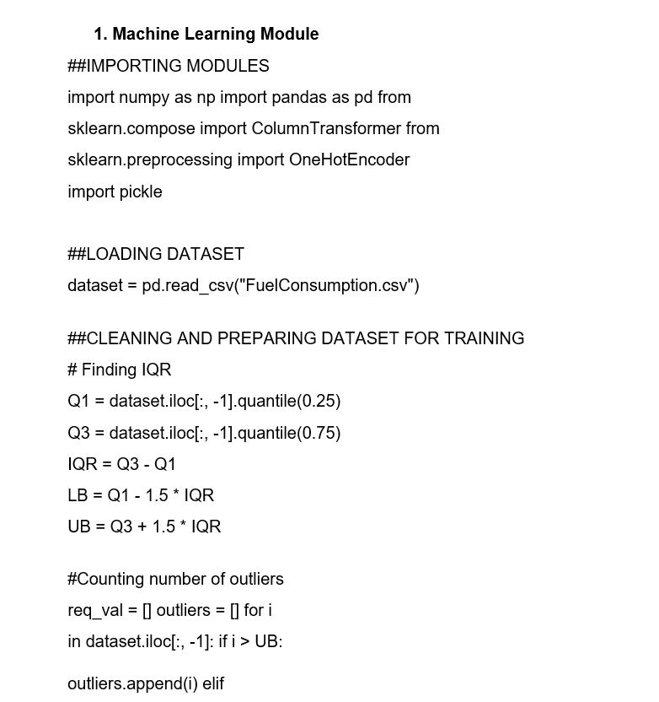
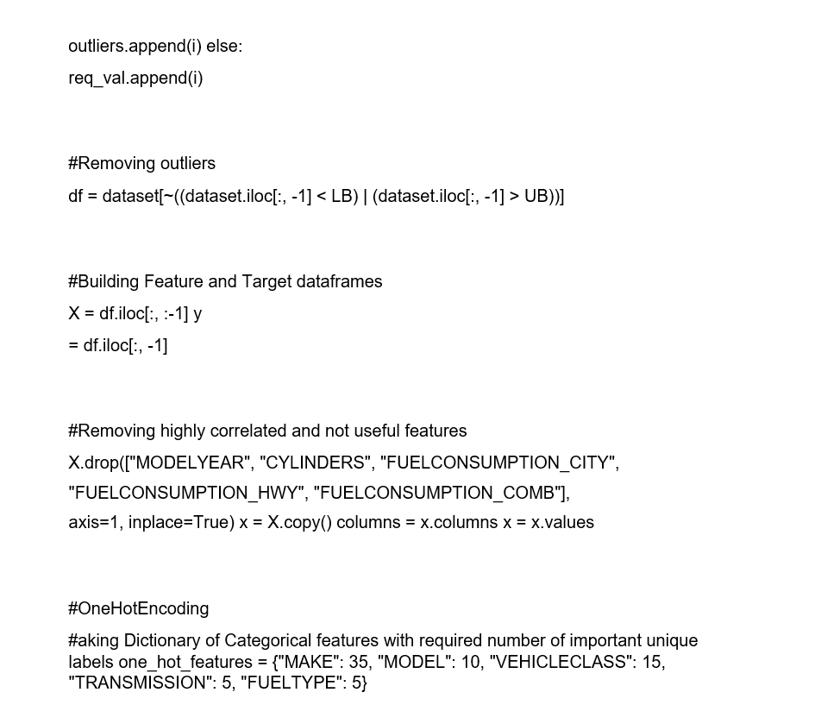
IMPLEMENTATION

Slide 4
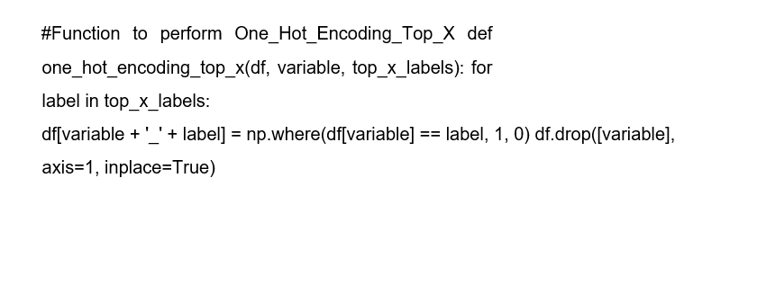
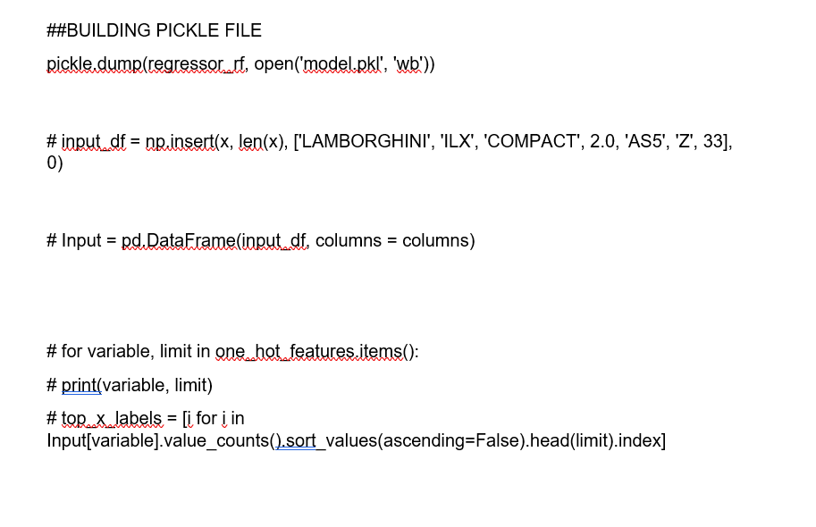
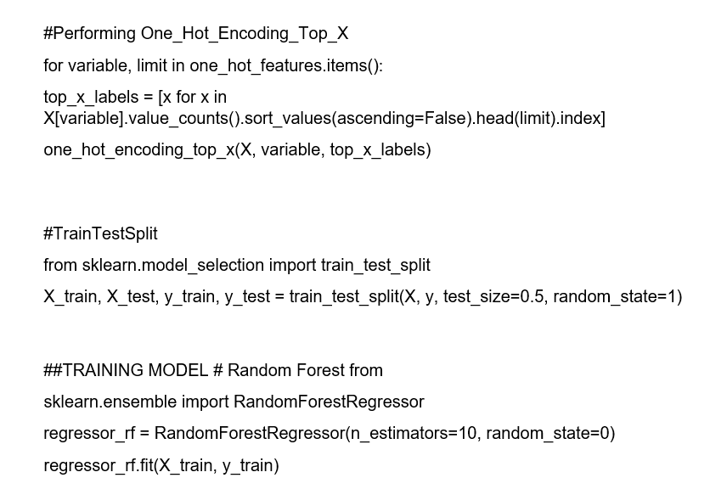

Slide 5
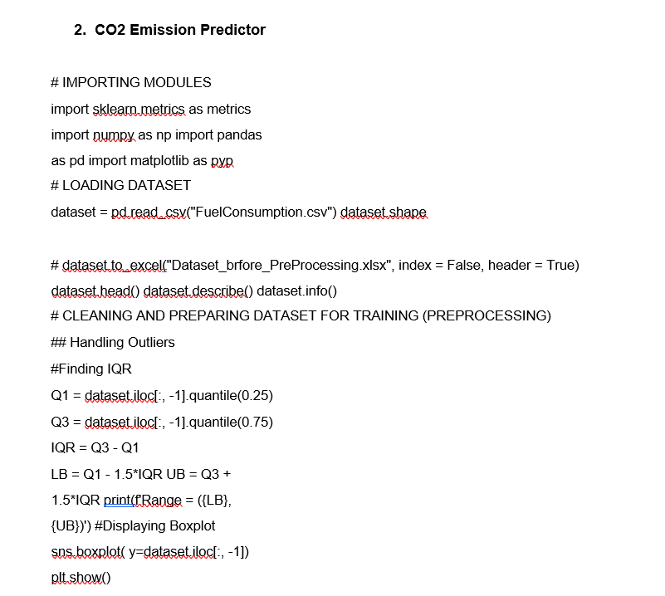

Slide 6
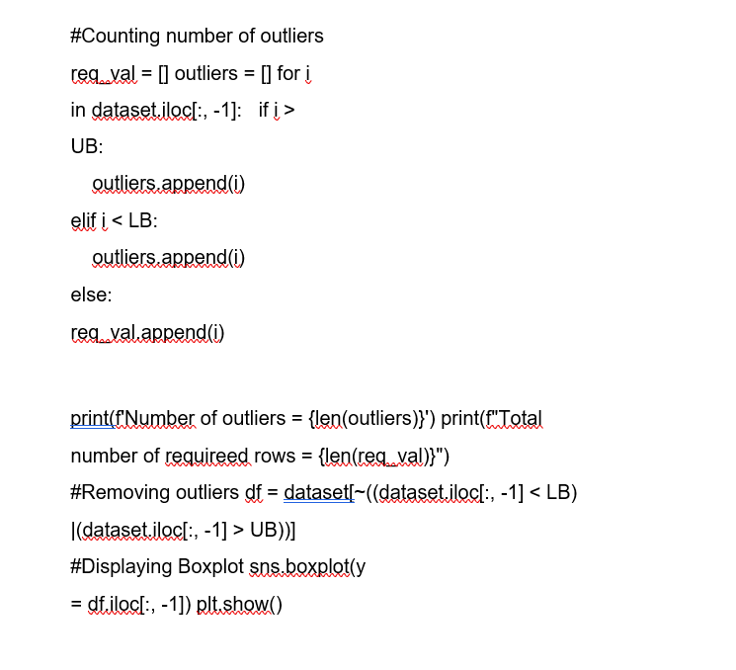
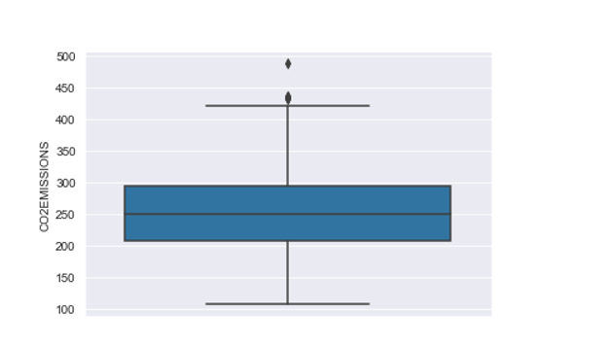

Slide 7
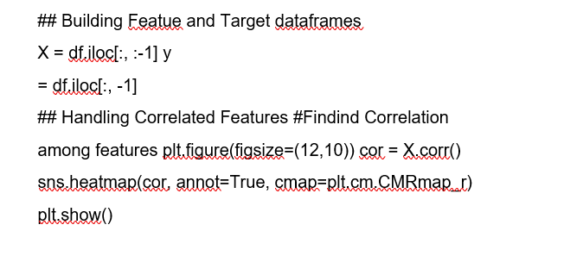
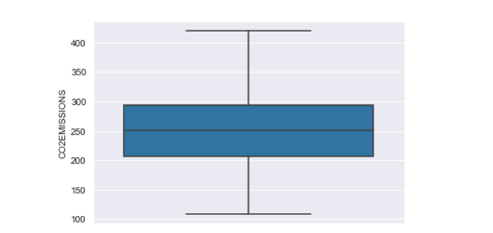

Slide 8
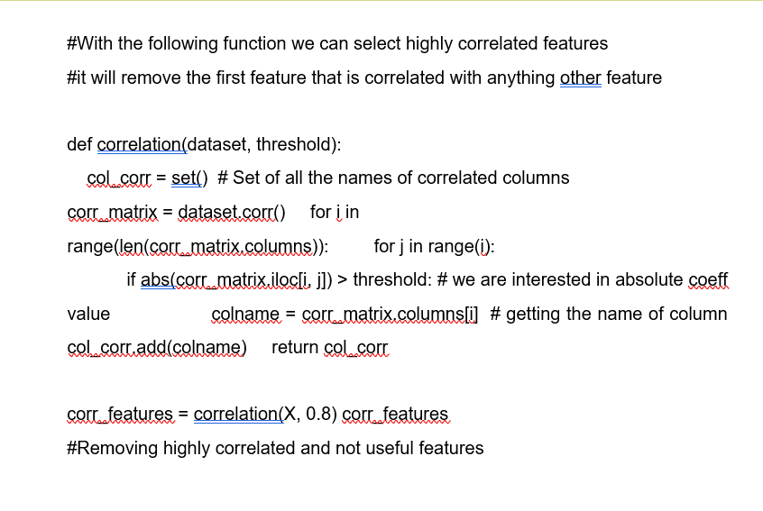
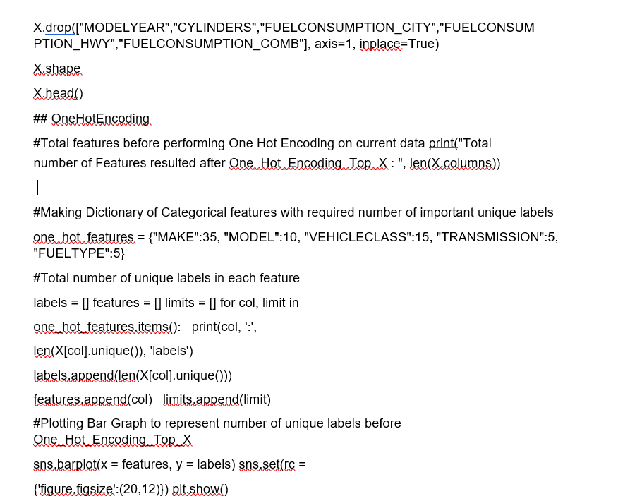

Slide 9
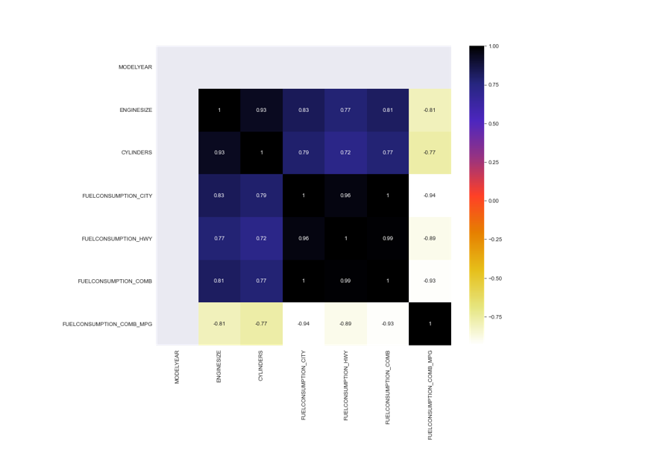

Slide 10
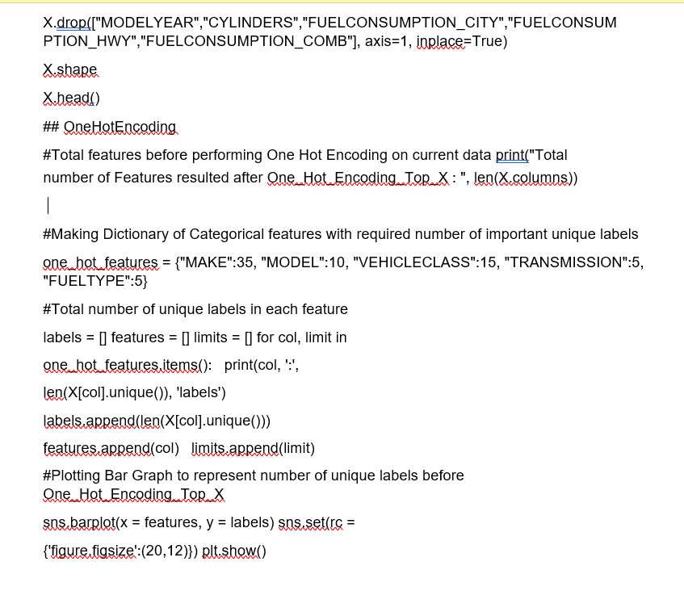
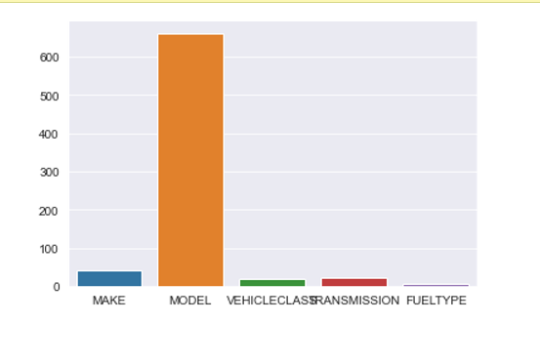

Slide 11
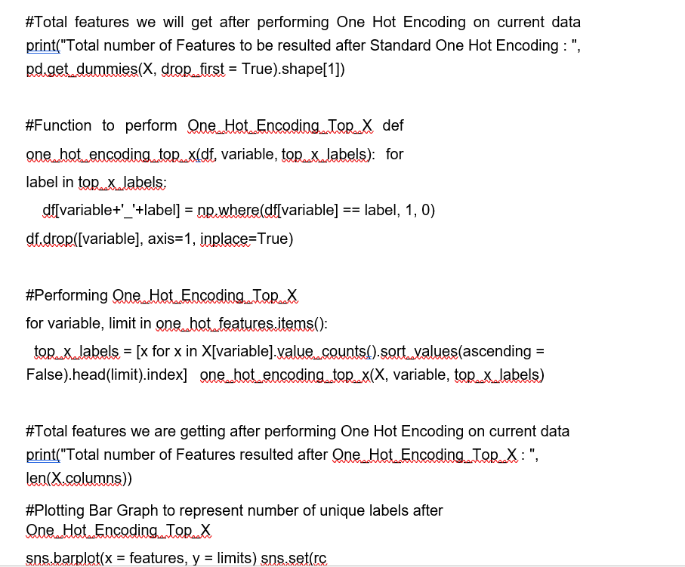
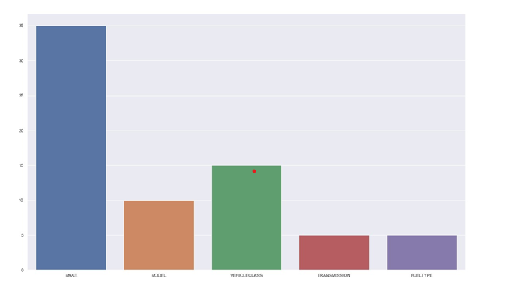

Slide 12
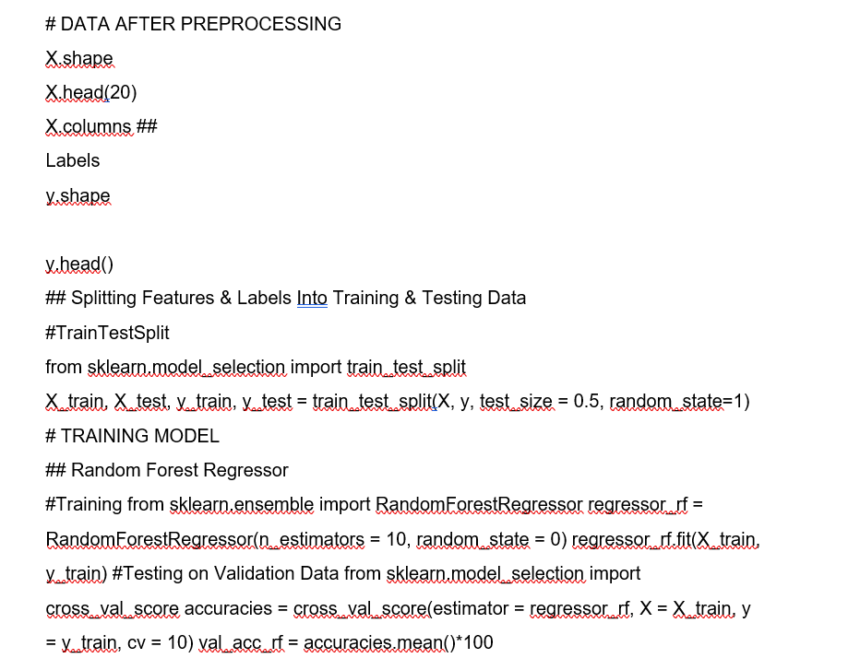
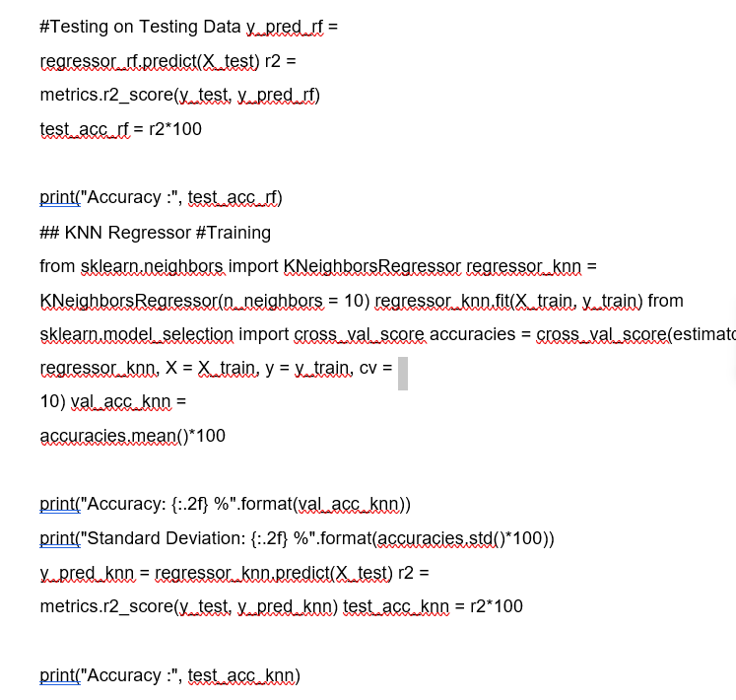

Slide 13
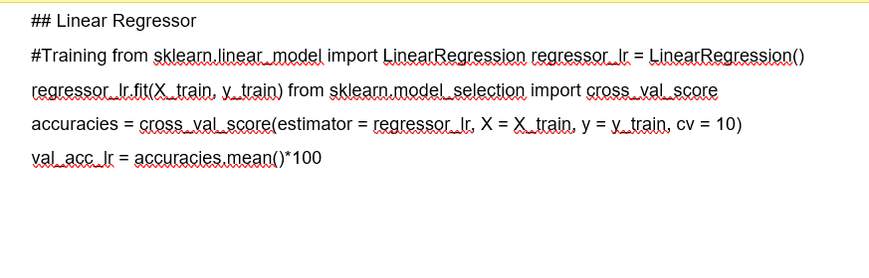
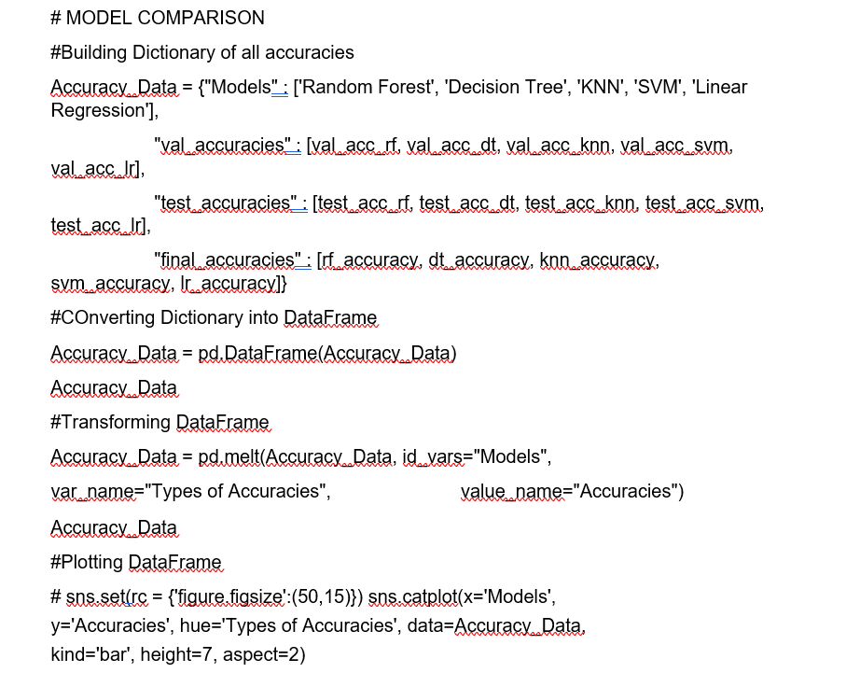
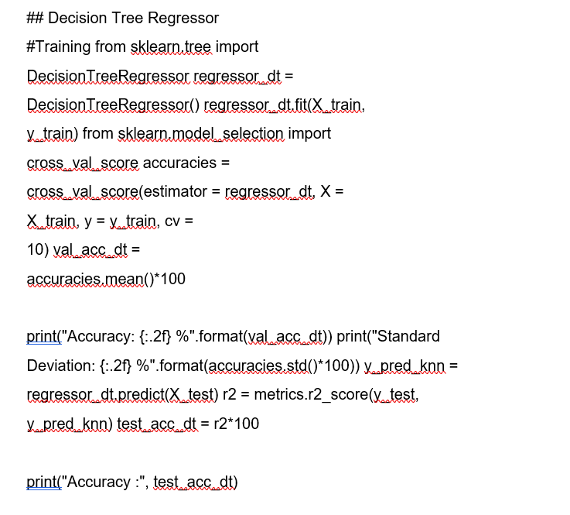

Slide 14
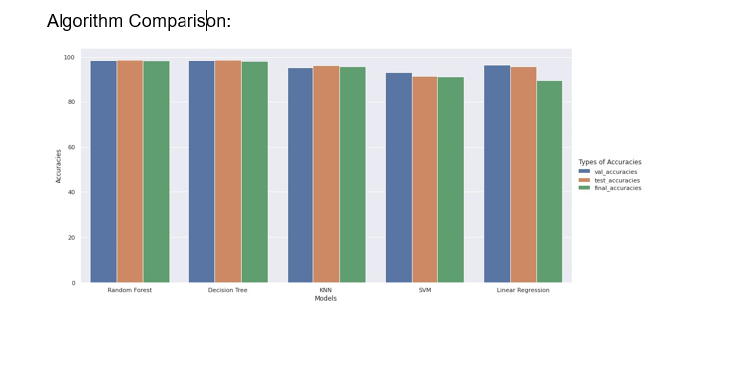

Slide 15
ACCEPTANCE CRITERIA
Acceptance criteria are specific and measurable criteria that must be met in order for the project to be considered successful. Here are some possible acceptance criteria for a carbon footprint emission project:
The system must accurately calculate carbon emissions based on user inputs.
The system must be easy to use, with a user-friendly interface.
The system must be accessible from a variety of devices, including desktop computers, laptops, tablets, and smartphones.
The system must be secure, with appropriate safeguards in place to protect user data.
The system must provide users with a clear and detailed breakdown of their carbon footprint, including recommendations for reducing their emissions.
The system must be scalable, able to handle a large number of users and data inputs without slowing down or crashing.
The system must comply with all relevant laws and regulations regarding carbon emissions and data privacy.
The system must be tested thoroughly to ensure accuracy, reliability, and usability.
The system must be delivered on time and within budget.
The system must receive positive feedback from users, indicating that it is meeting their needs and expectations.

Slide 16
REFERENCES
IPCC 2014 Climate Change 2014 Synthesis Report: Headline statements from the Summary for Policymakers
IPCC 2007 Synthesis Report. Contribution of Working Groups I, II and III to the Fourth Assessment Report of the Intergovernmental Panel on Climate Change
Dayaratne S P and Gunawardana K D 2014 Carbon footprint reduction: a critical study of rubber production in small and medium scale enterprises in Sri Lanka J. Clean. Prod.
Wiedmann T, Minx J, Barrett J and Wackernagel M 2006 Allocating ecological footprints to final consumption categories with input--output analysis Ecol. Econ. 56 28– 48
Wiedmann T and Minx J 2007 A Definition of ‘ Carbon Footprint Science (80-. ). 1 1–11
Andrić I, Jamali-Zghal N, Santarelli M, Lacarrière B and Le Corre O 2015
Environmental performance assessment of retrofitting existing coal fired power plants to co-firing with biomass: carbon footprint and emergy approach J. Clean. Prod. 103 13– 27
Grubb T and Ellis C 2007 Meeting the carbon challenge: The role of commercial real estate owners Users Manag. Chicago
Jones C M and Kammen D M 2011 Quantifying carbon footprint reduction opportunities for US households and communities Environ. Sci. Technol. 45 4088–95

